Slide 1

What is Scrum?
Martin schray

Slide 2
What is Scrum?
What is scrum?
What is it good for?
Who is involved in scrum?
What are the events (ceremony) in Scrum?
What are the artifacts in scrum?

Slide 3
What is scrum?

Slide 4
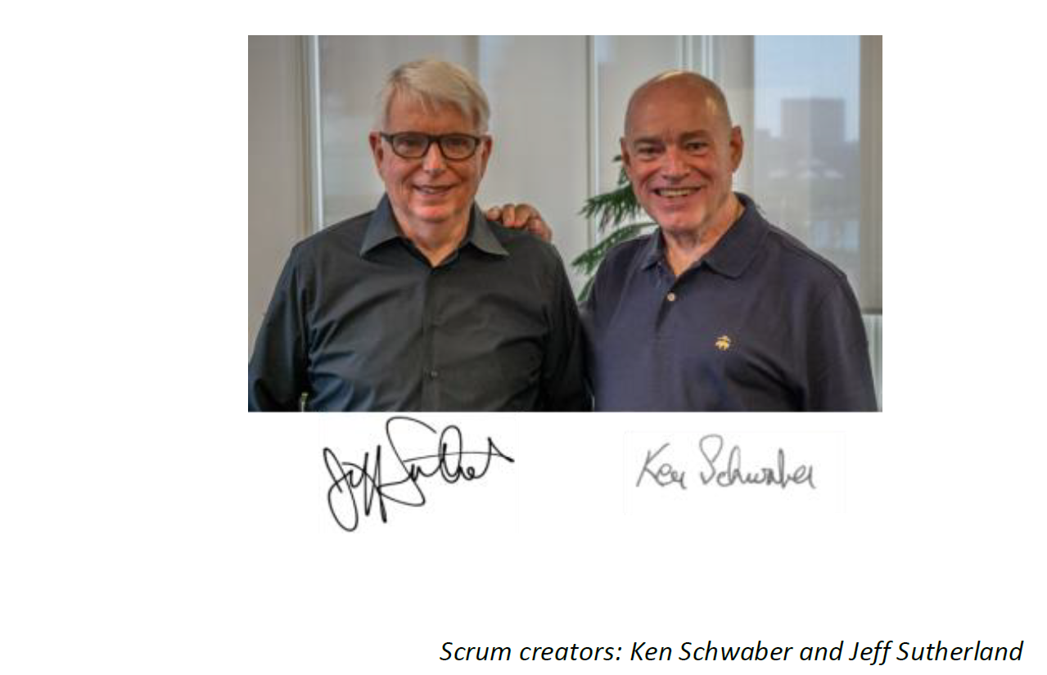
What is scrum
Where did Scrum come from?

Slide 5
What is scrum?
Scrum is not a process, technique, or definitive method …
What you do include that framework is up to you
Scrum is a framework within which you can employ various processes and techniques.

Slide 6










Why scrum?

Slide 7
Why scrum?
List of rules for simple tasks
Making a hamburger
Making a burrito
…

Slide 8
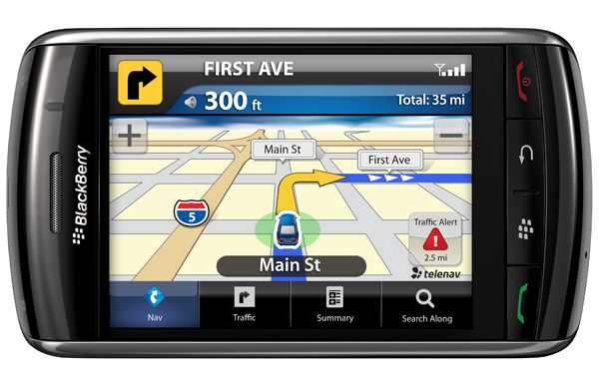
Why scrum?
This Photo by Unknown Author is licensed under CC BY-SA
Not easily reproducible
Build complex software
Complete a complex project (IPro)
Any effort with many stakeholders
Efforts with many unknows and uncertainty
Scrum excels at these tasks

Slide 9
Scrum is empirical process
Inspection
Adaption
Transparency

Slide 10
Roles in scrum

Slide 11

Roles in Scrum
Product owner
Development Team
Scrum Master

Slide 12
What does each role do?
Product owner – responsible to capture value for the business
Development Team – responsible to deliver product incrementally
Scrum Master – Guide to Scrum

Slide 13
Ceremonies (Events/meetings) in scrum

Slide 14
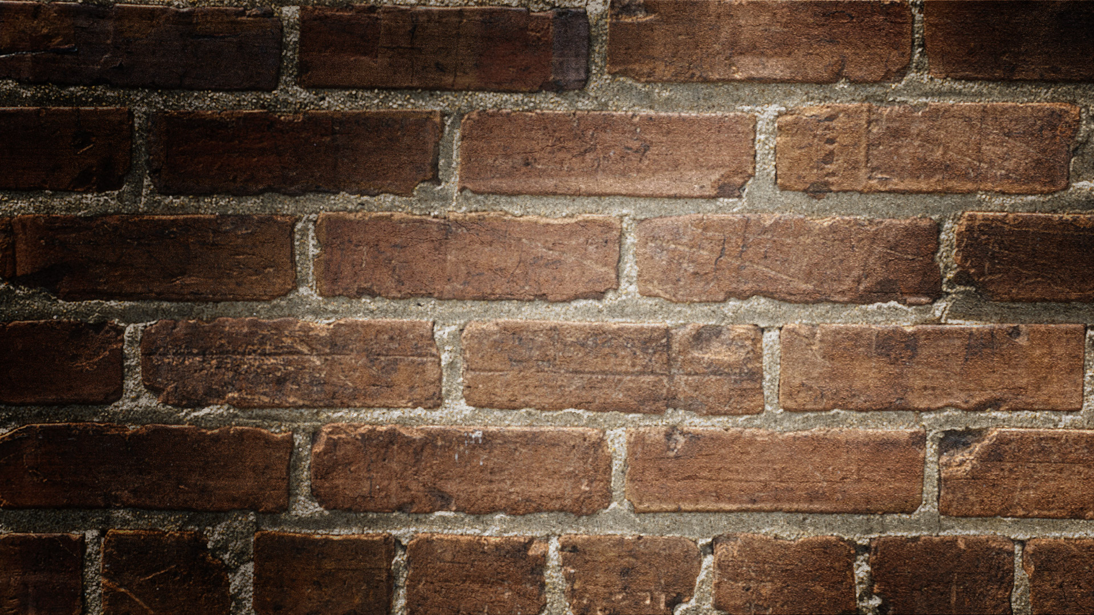

Agile Ceremonies
Scrum or daily standup
(1 o 4 weeks)
Sprint Review
Sprint Retro
Sprint planning

Slide 15
Scrum Values
Focus
Openness
Respect
Courage
Commitment

Slide 16
Artifacts in scrum

Slide 17
Artifacts
Product Backlog
Sprint Backlog
Product increment

Slide 18

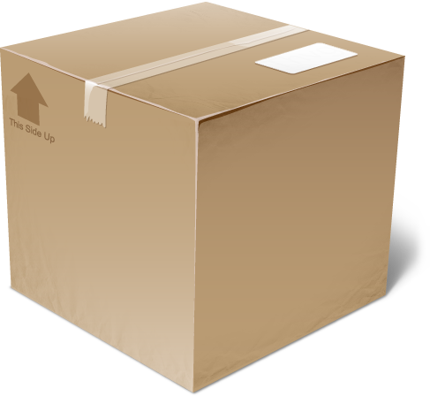
The Sprint
Scrum or daily standup
(1 to 4 weeks)
Sprint Review
Sprint Retro
Sprint
Backlog
Product
Backlog
Sprint planning
Product
increment

Slide 19
